Slide 1
CELL THEORY:
All living things are made up of cells
Cells are the smallest working unit in all living things
All cells come from existing cells
Organisms are made up of cells!

Slide 2
2 TYPES OF CELLS
Prokaryote: organism that has no nucleus and no cell membrane
Eukaryote: organism that has a nucleus and a cell membrane

Slide 3
Organisms are classified by
Type of Cells
How They Obtain Food/Nutrients
Type of Reproduction

Slide 4
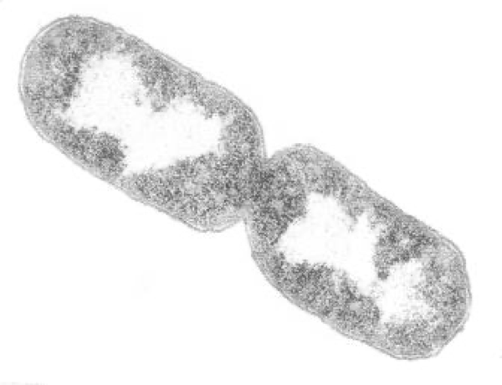
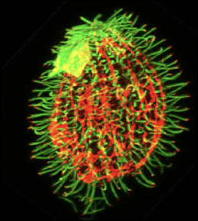
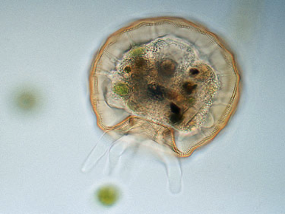
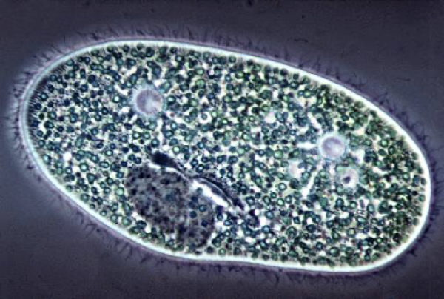
Cells and Types of Organisms
Unicellular – organism made of only 1 cell (single celled organism)
Characteristics / Examples:
Very small – microscopic
(cannot be seen without a microscope).
Examples: bacteria, virus, amoeba, paramecium, many others.

Slide 5
Cells and Types of Organisms
Multicellular (many celled) - an organism made of 2 or more cells.
Characteristics / Examples:
Most can be seen without magnification.
Examples: Birds, trees, mushrooms, and many others

Slide 6
Food and Nutrients
Autotrophs – make their own food using energy from the sun.
Plants conduct photosynthesis using chloroplasts inside their cells that capture the Sun's energy.
Other types of organisms can do this as well sometimes such as some bacteria and fungi.
Heterotrophs – depend on eating other organisms to get food and nutrients. Animals, Fungi, Protists, Bacteria and some Archaea

Slide 7
Types of Reproduction:
Asexual Reproduction – 1 parent replicates itself or divides into two identical cells.
Sexual Reproduction – 2 parents, cell has half of the mom's material and half of the dad's material (DNA), cell is not identical to parents.

Slide 8
ORGANISMS
DOMAINS AND KINGDOMS
3 DOMAINS
BACTERIA
ARCHAEA
EUKARYA
Kingdom Bacteria
Kingdom Archaea
Kingdom Animalia
Kingdom Plantae
Kingdom Fungi
Kingdom Protista
Domain: Organisms belong to 1 of 3 domains.
Domain is the largest level of classification.

Slide 9
Kingdoms are the 2nd level of classification of living things.
There are 6 Kingdoms of Classification

Slide 10
Kingdom Bacteria:
Prokaryotes
Unicellular
Reproduce Asexually
Heterotroph and some are Autotrophs
Examples: Ecoli, Salmonella, yogurt

Slide 11
Kingdom Archaea:
Prokaryotes
Unicellular
Reproduce Asexually
Heterotrophs and Autotrophs
Examples the extremely small microorganisms that live in the human intestinal tract.

Slide 12
Kingdom Protista:
Eukaryotes
Unicellular or Multicellular
Autotroph or Heterotroph
Sexual or Asexual Reproduction
Examples: Amoebas and Paramecium

Slide 13
Kingdom Plantae:
Eukaryote
Multicellular
Autotroph (makes food using chloroplast in the cells to capture sunlight for photosynthesis.)
Examples: Grass, flowers, plants, trees.

Slide 14
Kingdom Animalia
Eukaryote
Multicellular
Heterotroph
Sexual Reproduction
Examples: Foxes, Cats, Rabbits, etcccc

Slide 15
Kingdom Fungi:
Eukaryote
Multicellular
Sexual Reproduction / some asexual reproduction
Heterotrophs
Examples: mushrooms, molds, and yeast

