Slide 1


World Scholar’s Cup

Slide 2

What is WSC?
WSC, or the World Scholar’s Cup, is a global competition building on students’ talents and strengths as they compete in various events.
WSC was built as a global version of Decathlon, as international students wanted to compete in something similar to USAD.
The World Scholar’s Cup is built of 4 events, each engaging a different skill that students may have in order to create well-rounded individuals.

Slide 3

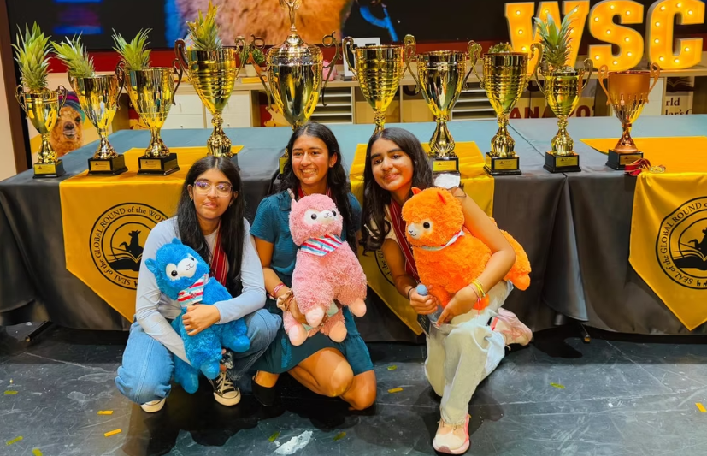
Subjects
Each year, WSC releases a new theme
There are 6 subjects in every theme
  Science & Technology
  Special Area
  Social Studies
  History
  Art & Music
  Literature & Media

Slide 4
What Events Are There?
Scholar’s Bowl
Collaborative Writing
Scholar’s Challenge
Team Debate

Slide 5
Events
Scholar’s Challenge
Collaborative Writing
Team Debate
Scholar’s Bowl
120 Questions
6 Prompts
3 Rounds
One Room, One Clicker
60 Minutes
5 Options
One* Right Answer
Collaborate, Write, Review
15 Minute Prep
Speeches
Feedback
30 Seconds

Slide 6
What Will We Do?
We will help students on:
Creative Writing
Study Material
Debate Skills

Slide 7
Debate
Debate Structure & Timing
Teams: Two teams (Government/Opposition) with 3 speakers each.
Speech Times: 8 minutes for main speeches, 4 minutes for reply speeches.
Points of Information (POIs): Offered by the opposing team during the 2nd to 7th minute of a speech; the speaker can accept or reject.
Protected Time: The first and last full minute of a substantive speech are protected from POIs.
Debate Structure & Timing
Teams: Two teams (Government/Opposition) with 3 speakers each.
Speech Times: 8 minutes for main speeches, 4 minutes for reply speeches.
Points of Information (POIs): Offered by the opposing team during the 2nd to 7th minute of a speech; the speaker can accept or reject.
Protected Time: The first and last full minute of a substantive speech are protected from POIs.
Teams: Each team consists of three speakers.
Motions: These are statements or propositions that teams will argue for (affirmative/proposition) or against (negative/opposition).

Slide 8
Debate
Debate Structure & Timing
Teams: Two teams (Government/Opposition) with 3 speakers each.
Speech Times: 8 minutes for main speeches, 4 minutes for reply speeches.
Points of Information (POIs): Offered by the opposing team during the 2nd to 7th minute of a speech; the speaker can accept or reject.
Protected Time: The first and last full minute of a substantive speech are protected from POIs.
Debate Structure & Timing
Teams: Two teams (Government/Opposition) with 3 speakers each.
Speech Times: 8 minutes for main speeches, 4 minutes for reply speeches.
Points of Information (POIs): Offered by the opposing team during the 2nd to 7th minute of a speech; the speaker can accept or reject.
Protected Time: The first and last full minute of a substantive speech are protected from POIs.
Speaking Order: Speakers from each team alternate. A common order is: 1st Affirmative, 1st Negative, 2nd Affirmative, 2nd Negative, 3rd Affirmative, 3rd Negative.
Speaking Time: Each speaker has 4 minutes.
Preparation Time: Before each debate, teams are given the motion and 15 minutes preparation time to discuss their strategy and arguments and 1 minute between each speakers to write rebottles.
Feedback: 1 minute to prepare feedback

Slide 9
Coaching
We will coach teams for all 4 events in 3 areas:
Creative Writing:
Collaborative Writing thrives from creative writing. We will coach students on how to write unique pieces of text, from stories to monologues, anything goes in WSC!
Study Material:
WSC releases a lot of material for competitions. We provide study sessions, cram notes, and many other materials for students to excel in events.
Debate Skills:
Team Debate is reliant on good speaking, great responses, and excellent teamwork. Coaching includes skill sessions, speaking drills, and practice debates.

